Slide 1
MAP SYMBOLS

Slide 2
What do you think this symbol means?
Railway Station

Slide 3
What do you think this symbol means?
Bus/Coach Station

Slide 4
What do you think this symbol means?
Motorway

Slide 5
What do you think this symbol means?
Main Road

Slide 6
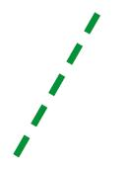
What do you think this symbol means?
Footpath

Slide 7
What do you think this symbol means?
Campsite/Caravan Site

Slide 8
What do you think this symbol means?
Picnic Site

Slide 9
What do you think this symbol means?
Sports Centre

Slide 10
What do you think this symbol means?
Cycle Trail

Slide 11
What do you think this symbol means?
Parking

Slide 12
What do you think this symbol means?
Public Telephone

Slide 13
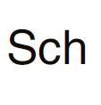
What do you think this symbol means?
School

Slide 14
What do you think this symbol means?
Church/Place of worship

Slide 15
What do you think this symbol means?
Church with a spire

Slide 16
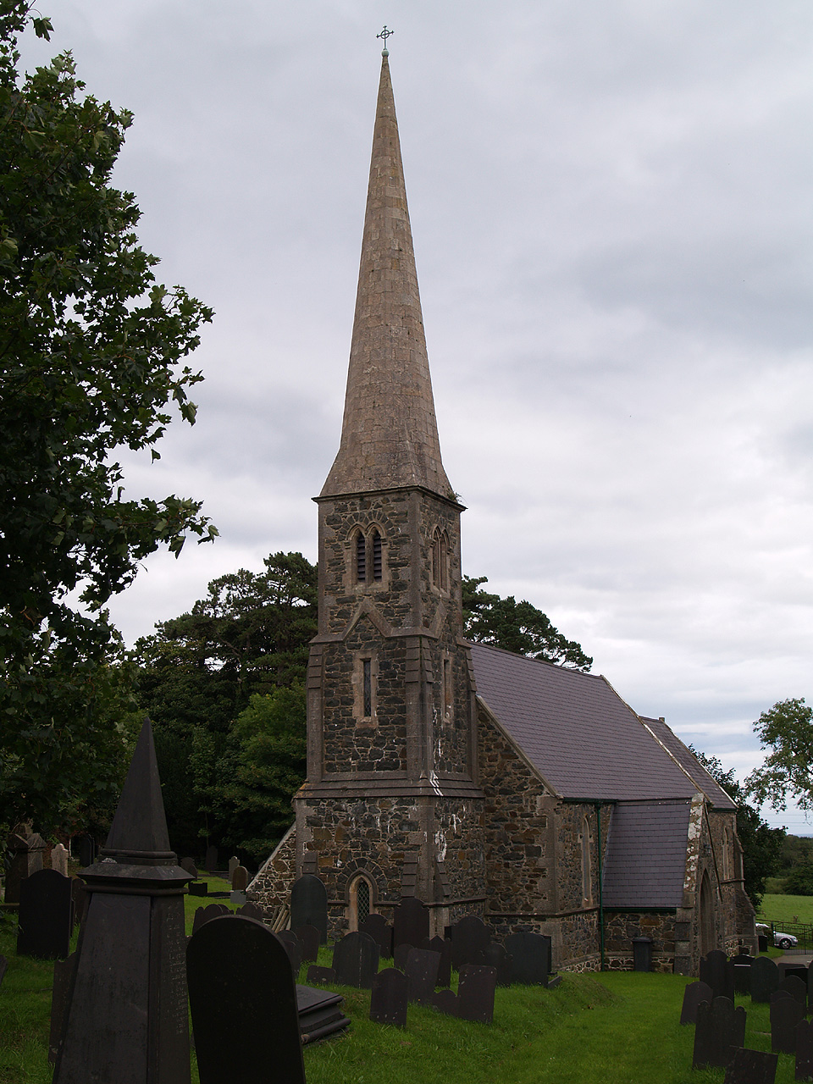

Slide 17
What do you think this symbol means?
Church with a tower

Slide 18
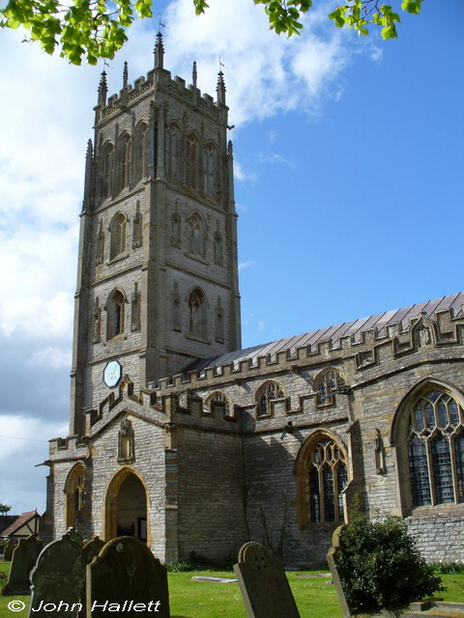

Slide 19
What do you think this symbol means?
Public Convenience

Slide 20
What do you think this symbol means?
Viewpoint

Slide 21
What do you think this symbol means?
Pub

Slide 22
What do you think this symbol means?
Golf Course

